Slide 1
Nov’17
India Energy Forum
Health of Distribution Sector…
Gopal Saxena
BSES Delhi

Slide 2
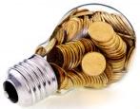
Reality Check…
AVAILABILITY
POWERLESS AREAS
Daily Load Shedding
Unplanned Outages
...norm in large parts of country
…1% Peak Shortage (YTM Sep’17)
( Ground Reality ???)
Ahmedabad , Gandhinagar, Surat , Mumbai, Kolkatta…
AFFORDABILITY
ACCESS
Distribution contributes 80% of losses
FRPs failed to curb financial mess of state discoms
“Rampant Power Theft” - plaguing society at large
‘Ability to Pay’ still driven by the Purchasing Power Parity (PPP)
Areas without electricity
Electrified areas with high New Connection pendency
Unelectrified Villages
~260million people w/o electricity
SEBs surviving on Govt aid/ subsidy
~800 million Indians use traditional fuels for cooking /general heating needs
→ 80 billion KWh generated by DG sets annually (~15 million tons of diesel oil)
Source : World Wide Web

Slide 3
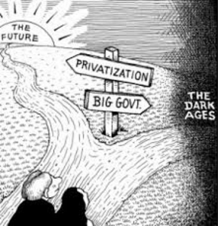
State Board Performance…
90% of DISCOMs are with State Governments; majority are:
high on losses & costs
higher on tariffs & heavily subsidised
low on Operational Efficiency , n/w reliability..
minimal adherence to SOPs / Supply Codes & 24X7 Supply
lack innovation for customer convenience
Privatisation has shown commendable operational improvement despite this NO Privatisation (PPP) has taken place post enactment of the Electricity Act 2003
Future Of Distribution is Private / PPP Model built on transparency /good governance
....current model is riddled with disputes (Financial /Operational /Legal /Regulatory)

Slide 4
Challenges…

Slide 5
Discom Challenges [Internal]
Financing & associated costs.
Highly capital intensive
Vicious Cycle trap (Operat’n Loss funded by high cost Debt)
CAPEX prioritization
Towards catering to New Demand Growth OR upgrading existing dilapidated legacy network.
Human Resource / Skill Development:
Highest Man : MW Ratio [Urban 1:5 ; Rural 1:10 ]
Resistance to change / Industrial Unrest / Union Activity
Absence of Training programs for all levels towards more technological advances
Lack Of Innovation :
“Distribution: Weakest link with least focus on R&D / Innovation”
Piece meal Development : Equipment / Meter/ IT Upgradation instead of complete turnaround
Full / Partial Cost Disallowances - Risk to be borne by the discoms/ promoters / developer.
Most empirical performance ratios out of line

Slide 6
Discom Challenges [External]
Electricity Tariff: Socio-political sensitive issue. Domestic / Agriculture tariffs heavily subsidised.
Optimizing REAL COST of Power : Efficient & progressive Discoms battling with burden of high cost PPAs instead of being allowed to renegotiate existing
Societal Environment :
Theft Control – high community resistance with minimal political/ police support .
Land Usage – minimal Policy framework for n/w extension
Regulatory Environment :
Unrealistic , Inadequate & non-cost reflective tariffs
The “projection-based” Return, has a book-entry while in actual, the deficits keep on mounting.
Overlooking / Defiance of the statutory orders (ATE/HC/SC) by the state regulator.
Strong disconnect between CERC & SERC thereby weakening discom & hence sector as a whole.
Policy discriminating between Public and Private DISCOMs, benefitting end consumers

Slide 7
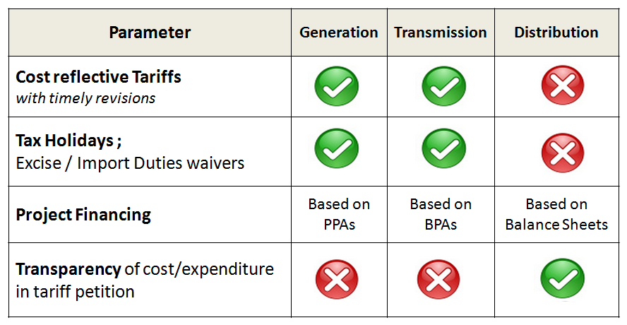
Parity with Generation / Transmission
Reduce Disparity Across the Power Chain

Slide 8
Per Capita Electricity consumption
Aspiration
~2000 kWh / capita
by Yr 2024
Per capita annual electricity consumption (kWh, 2015)
1075 kWh / capita
in Yr 2016
Required
Investment
Rs ~30* lakh Crs
1/3rd of Global Average
Increase @ 6% CAGR in the last decade
At Rs 10 Cr/MW (6 Cr Gen. capacity, 1.5 Cr X’mission, and ~2.5 Cr Distribution CapEx - smart meters, etc.)
Source : Wold Wide Web

Slide 9
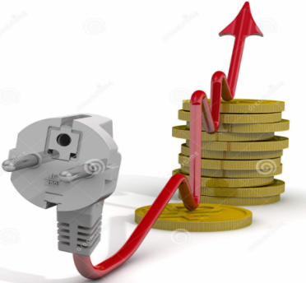
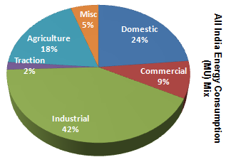
Demand Revival ….
Getting UDAY on track on Operational Issues -
Post 2019, tariff fixation to be based on UDAY targets; & states to provide adequate subvention for any AT&C losses above the targets
Pradhan Mantri Sahaj Bijli Har Ghar Yojana – “SAUBHAGYA”
Rs 16,320 cr towards electrification over 40 million households (urban/rural) by Dec’18.
Will add to additional generation / transmission costs…
Incentivizing consumption for Industrial / Commercial category
Discourage Diesel Gensets for Power backup
….Estimated 72 GW of DG based capacity installed is at prohibitive costs
Demand Revival is imperative to absorb the Idling capacity, and to avoid build-up of Non-Performing Assets

Slide 10
Future Road Map
When Discoms do well, entire power sector would do well…

Slide 11
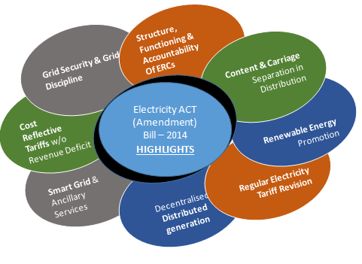
The Electricity Act (Amendment) Bill -2014
?
How
to bring
reforms
towards
Improving
.....
Accessibility
Affordability
Regulatory
Availability

Slide 12
Future Vision ...
Compacting & Miniaturization of
Network / equipments - lighter structures / enhanced properties.
Processes : simplified & transparent
Digital Technology (Data / Information) Management & Integration driven towards added value for customers through convergence of sensors /communication with household equipments & everything else connected.
Clean Energy / Distributed Generation with more effective storage : for remote electrification, load flattening & distributed load controls.
Reliable Operation/ Improved Grid Efficiency with Regulatory Support :
Meeting market demand with “lowest total cost” (Capex & Opex)
Cost reflective retail tariffs, linked with voltage wise cost of supply and differential tariff (peak, normal, off-peak hours)
Minimized negative externalities - environmental impacts, greenhouse gas emissions etc.
Project based initiatives : Rooftop Solar, Smart Grid, Internet of Things (IoT), Cognitive Analytics- self learning feedback loop, Smart Metering etc

Slide 13
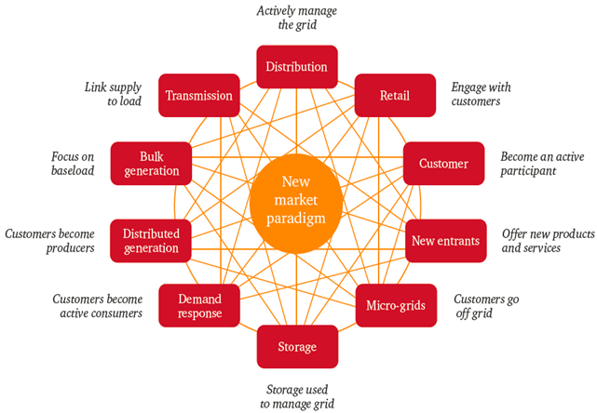
Future Business model....
NETWORKED MODEL
Integrated ecosystem of unique elements that are highly interrelated, notwithstanding the specific focus of these individual elements
Need to focus on extending beyond independent views of each value chain element into a more integrated view of how these elements can interact with each other in the future.
Non-traditional entrants will need to determine how they interact between incumbents and customers in a manner that does not ‘island’ assets or ‘diminish’ customer relationships.
More Stakeholders.. ….More interconnections …More conflicts than ever before...

Slide 14
Thank You

Slide 15
UDAY …
A Mixed Bag of Discom’s Performance !!!
Background: biggest financial engineering exercise of its kind carried out in the market. 26 States & 1 UT signed up. Simply put, State governments that accede to this scheme take over 75% outstanding debt of discom; balance is restructured by lending institutions can also get the backing of a State guarantee. Future losses of discoms to be progressively borne by State governments’ budgets; provided - discom has to meet certain performance metrics (pricing / losses etc).
Objective: AT&C loss target - 15% / ACS - ARR gap target - zero
Status ** Bonds Issued: 2.3 lac crs (86%); AT&C: 21.5% ; ACS-ARR Gap Rs 0.35/unit ; Tariff Revision: 25 of 27
Only three states could beat their target for Loss Reduction (Goa, Gujarat and Rajasthan). Improved efficiency, however, hides under-performance by several states.
Only four States could beat the ACS- ARR gap target (Gujarat, Haryana, Himachal Pradesh & U.P.). Performance on gap (Costs and Realisation) marginally better.
States allowed issuing non-SLR state development (SDL) bonds in the market or directly to banks or financial institutions holding the DISCOM debt. Due to these bonds, the state gross fiscal deficit ratio is up by 0.7 percentage points to 3.6 per cent in 2015-16 from 2.9 per cent without UDAY - Economic Survey, Volume II
Post 2019 tariff fixation should only be based on UDAY targets; and states should provide adequate subvention for any AT&C losses above the targets
**Source : Uday portal) : Progress shown above is as per data provided/ entered by respective State Utilities.

